Slide 1
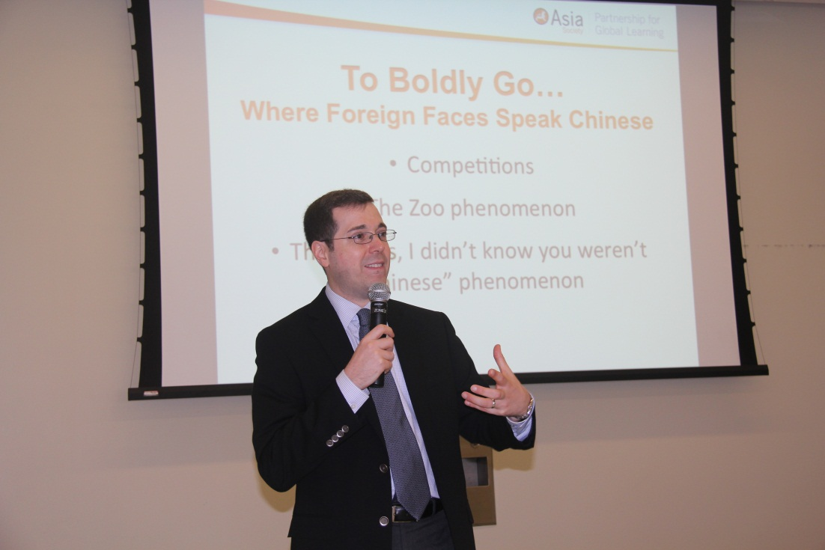
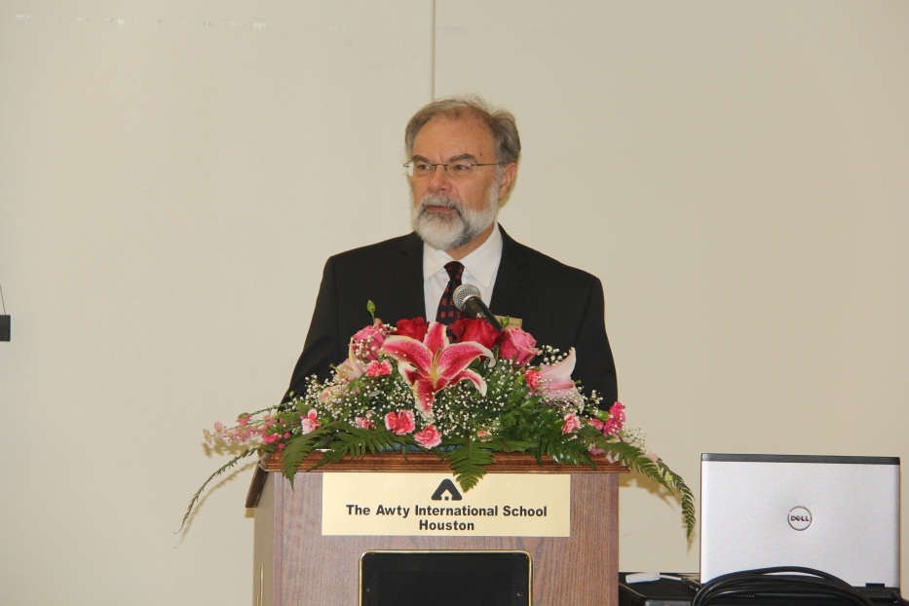
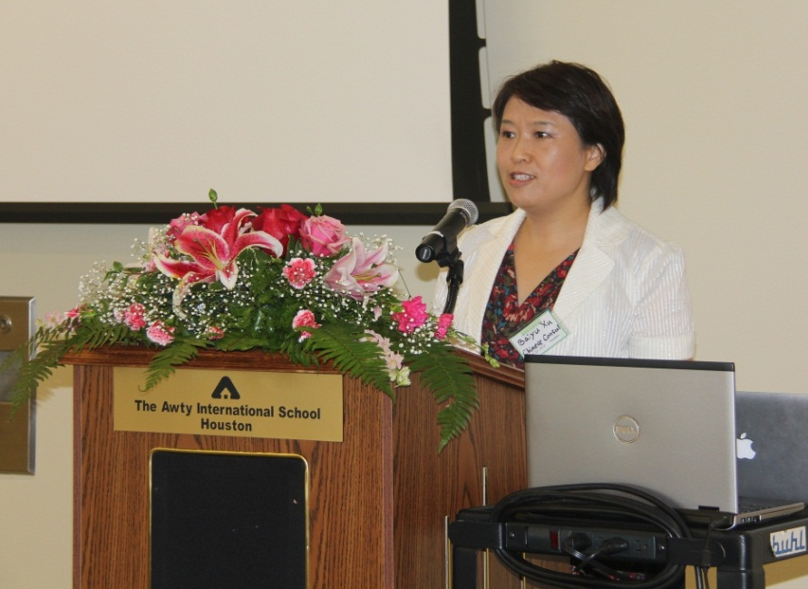
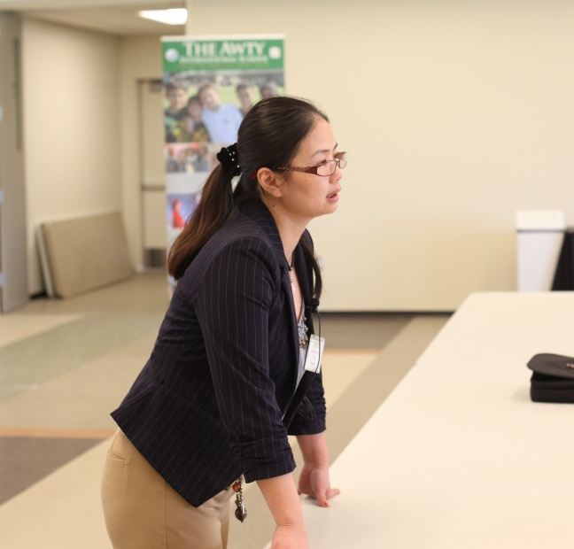
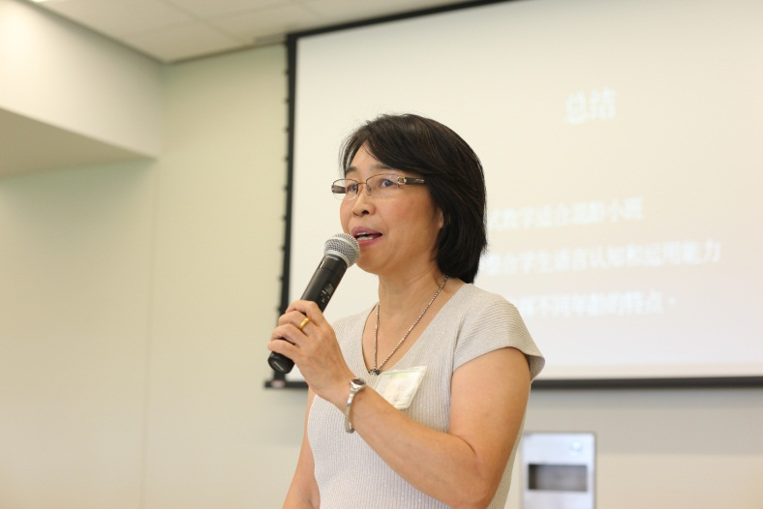
Christopher Livaccari, Director of Education and Chinese Language Initiatives Asia Society: "How Chinese Became a World Language: Teaching and Learning in the Age of Mandarin"
Dr. Steve Codrington, Headmaster of the Awty International School welcoming conference participants
Educational Consul Baiyu Xu giving an opening remark
Xiaohong Wen, University of Houston: “Instructional strategies in a student-centered classroom”
Rong Wang, Huaxia Chinese School & Galveston Independent School District: “My experience of teaching AP Chinese”

